Slide 1
SGD with Momentum

Slide 2
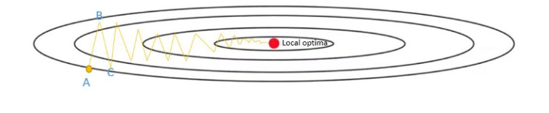
Challenges in SGD
The convergence path of SGD is noisier than that of original gradient descent. This is because in each step it is not calculating the actual gradient but an approximation. So we see a lot of fluctuations in the cost.

Slide 3
SGD with Momentum
Momentum or SGD with momentum is method which helps accelerate gradients vectors in the right directions, thus leading to faster converging.
The Exponentially Weighted Moving Average
The Exponentially Weighted Moving Average (EWMA) is commonly used as a smoothing technique in time series. However, due to several computational advantages (fast, low-memory cost), the EWMA is behind the scenes of many optimization algorithms in deep learning, including Gradient Descent with Momentum, RMSprop, Adam, etc.
The moving average is designed as such that older observations are given lower weights. The weights fall exponentially as the data point gets older – hence the name exponentially weighted.
In order to compute the EWMA, you must define one parameter alpha. This parameter decides how important the current observation is in the calculation of the EWMA.
The higher the value of alpha, the more closely the EWMA tracks the original time series meaning the more we try to get an average of more past data and vice-versa.

Slide 4
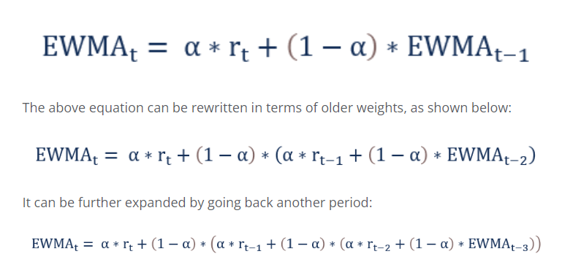
SGD with Momentum

Slide 5
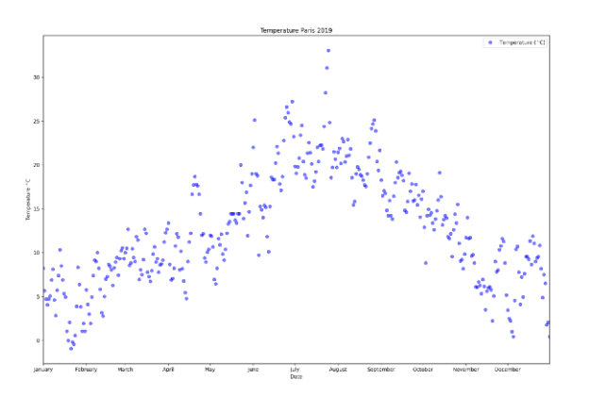
Example

Slide 6
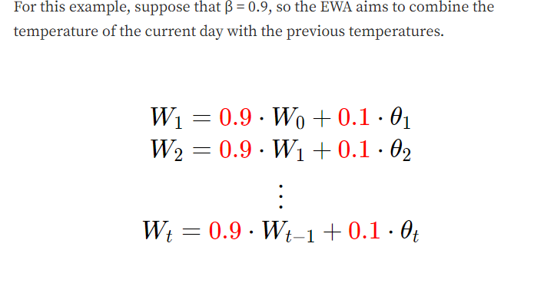
Example

Slide 7
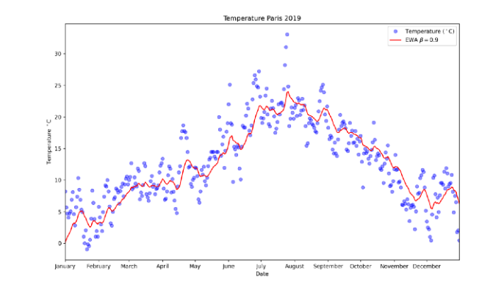
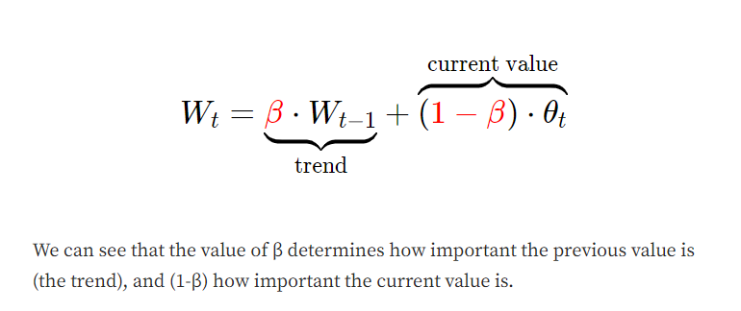
Example
If we plot this in red, we can see that what we get is a moving average of the daily temperature, it’s like a smooth, less noisy curve.

Slide 8
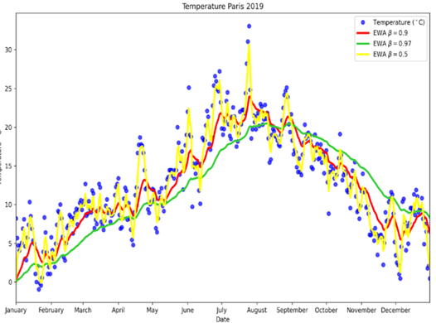
Example
Lets try the other extreme and set β = 0.5, this way the graph you get is noisier, because it is more susceptible to the current temperature (and this includes outliers).
But it adapts more quickly to changes in temperature.

Slide 9
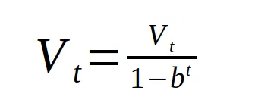
Smoothing
Bias-corrected version (optional)
Note b means Beta
Suppose b=0.1, then V=?
Suppose b=0.5, then V=?

Slide 10
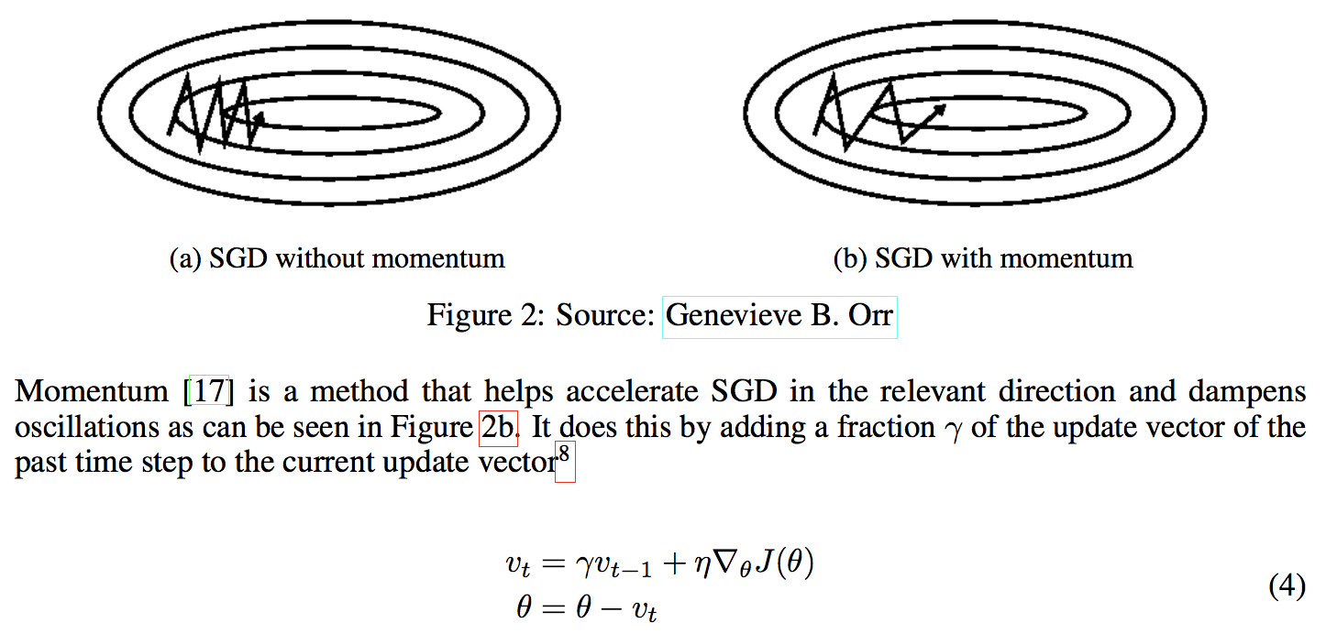
Momentum

Slide 11
Recall that the Gradient Descent Parameter update:
w_{t} = w_{t-1} - α * dMSE/dw
b_{t} = b_{t-1} - α * dMSE/db
For momentum, define a momentum, which is a moving average of the gradients. We then use it to update the weight of the network
w_{t} = w_{t-1} - α * v_{t}
b_{t} = b_{t-1} - α * v_{t}

Slide 12
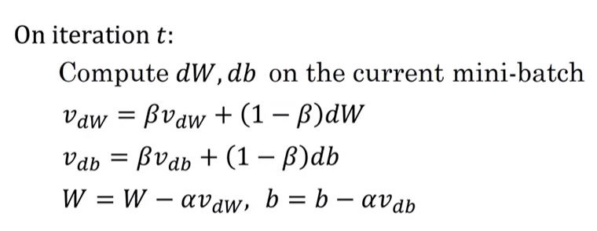
What if beta=0?

Slide 13
Note: Any variation of the Gradient Descent can work with momentum (i.e. SGD, batch, mini-batch)
Note 2: The following slides give an example of the calculations.
In this specific example, gradient descent without momentum resulted in faster updates, while gradient descent with momentum resulted in slower updates
The effectiveness of momentum depends on the specific characteristics of the optimization problem and the dataset.
In some cases, momentum can accelerate convergence, while in others, it may slow it down, as seen here.
The choice of whether to use momentum or not depends on the behavior of the optimization process and the problem at hand.

Slide 14
Solved Example
Assume w0 = 0
v0=0
Alpha = 0.1
Beta = 0.9
x | y
1 | 3
2 | 5
3 | 7

Slide 15
3. Calculate the gradients of the MSE with respect to m and c
dMSE/dm = (-2) * [(1) * (3 - 0)]/3 = -2
dMSE/dc = (-2) * [(3 - 0)]/3 = -2
dMSE/dm = (-2) * [(2) * (5 - 0)]/3 = -6.67
dMSE/dc = (-2) * [(5 - 0)]/3 = -3.33
dMSE/dm = (-2) * [(3) * (7 - 0)]/3 = -14
dMSE/dc = (-2) * [(7 - 0)]/3 = -4.67

Slide 16
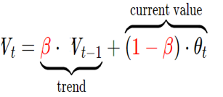
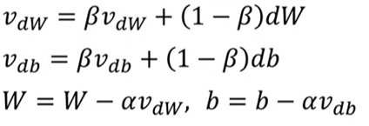
So velocity (w.r.t m) = 0.9*0 + (1-0.9)* [(-2 + -6.67 + -14) ]= -2.267
And velocity (w.r.t b) = 0.9*0 + (1-0.9)* [(-2 + -3.33 + -4.67) ] = -1
So m= 0 – (0.1)*(-2.267) = -0.2267
And b = 0 – (0.1)*(-1) = -0.1

Slide 17
Nesterov Accelerated Gradient (NAG)
Momentum accelerates the search to speed across flat areas and move with momentum at the bouncy gradients
Nesterov momentum is an extension of momentum that involves calculating the decaying moving average of the gradients of projected positions in the search space rather than the actual positions themselves
Can be thought of as a modification to momentum to overcome this problem of overshooting the minima

Slide 18
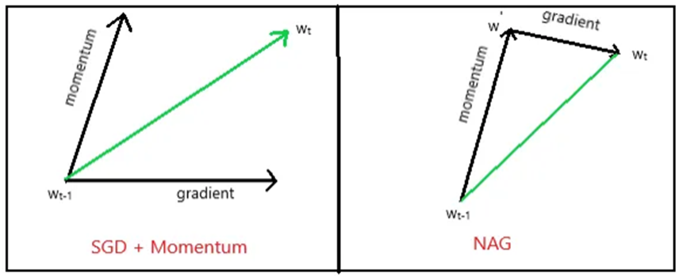
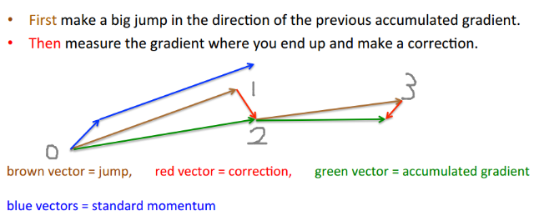

Slide 19
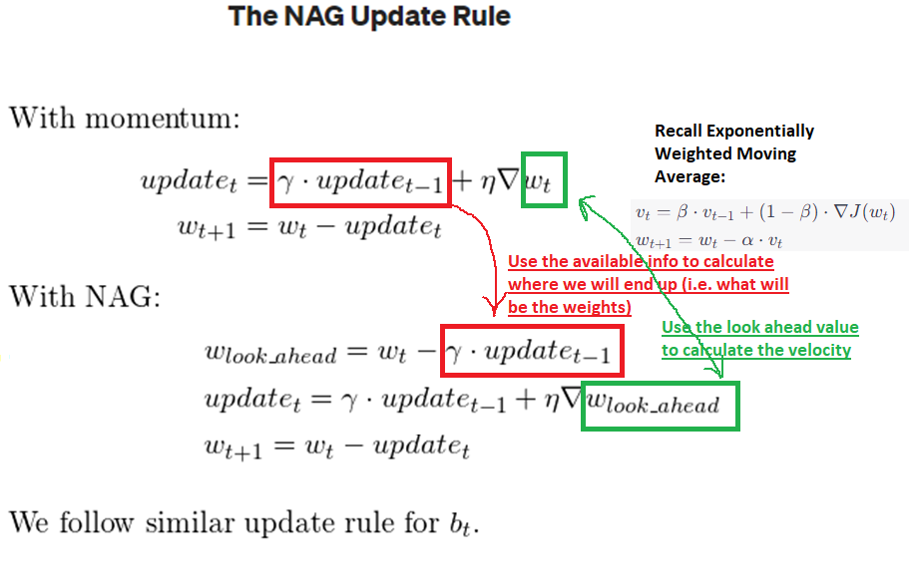

Slide 20
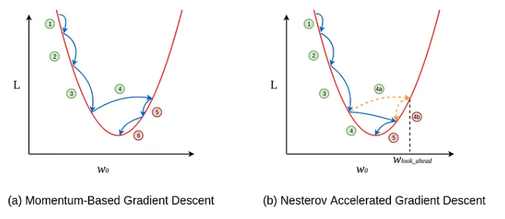

Slide 21
References
https://towardsdatascience.com/learning-parameters-part-2-a190bef2d12
https://machinelearningmastery.com/gradient-descent-with-nesterov-momentum-from-scratch/
https://github.com/campusx-official/deep-learning-optimizers#deep-learning-optimizers

